Slide 1
Funding the Organization through Supply Chain Finance: A longitudinal investigation
Jerry Huff, PhD
Arizona State University
June 2019

Slide 2
Jerry Huff, PhD
Academic (Arizona State University)
PhD – Supply Chain Management (2016)
MBA (2008)
BS – Industrial Engineering (1999)
Professional
Intel Corporation (8 yrs)
SubZero Inc (4.5 yrs)
Arizona State University (5 yrs)
Avnet (3 yrs)
Teaching Experience
Supply Chain Management, General Business, Marketing, Management, Entrepreneurship

Slide 3
Agenda
Introduction
Data Source
Analysis Methodology
Conclusion

Slide 4
Supply base relationships
Material Flow
...
...
Information Flow
Financial Flow
Transition to network view (Borgatti and Li, 2009; Choi and Kim, 2008; Galaskiewicz, 2011)
Traditional buyer-supplier research (e.g. Agrawal and Nahmias, 1997; Ellram, 1990; Ogden and Carter, 2008)
This research analyzes supply base strategies over time

Slide 5
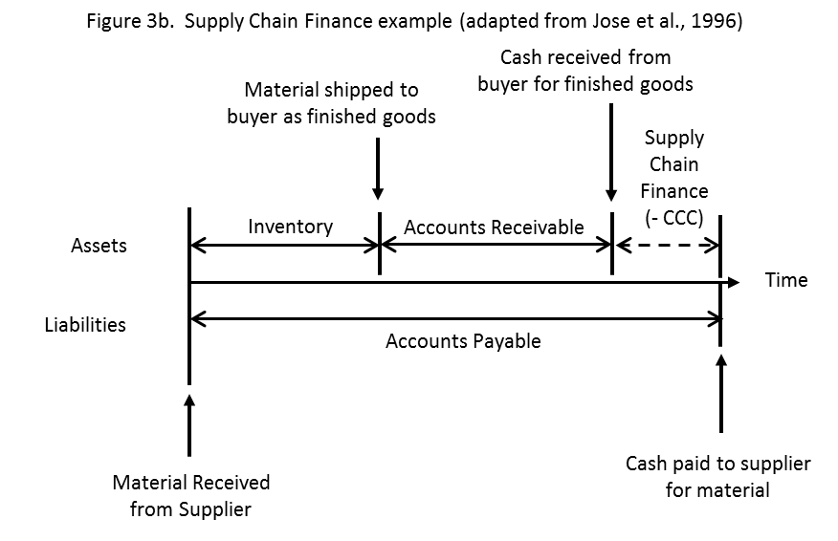
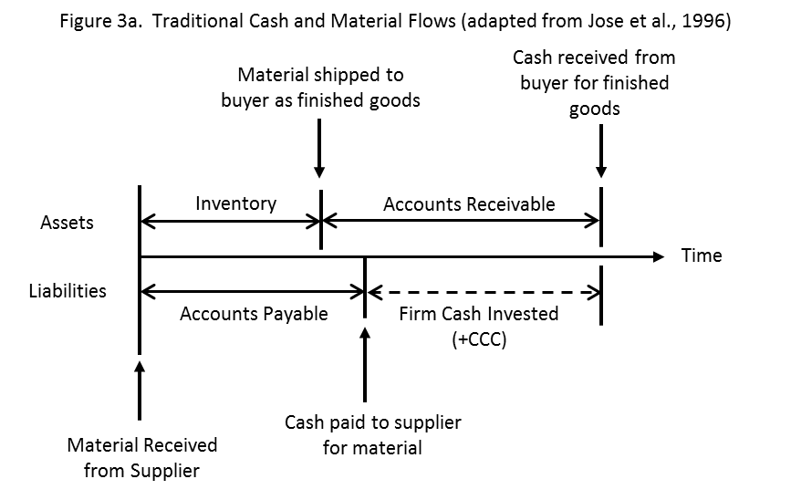
Supply Chain Finance
Notes:
Inventories on-hand dropped from over 80 days to less than 2 days; the number of days to get paid by customers dropped from almost 64 days to 40.5 days; and starting in 1996, the number of days to pay suppliers increased from 33 days to 68 days.

Slide 6
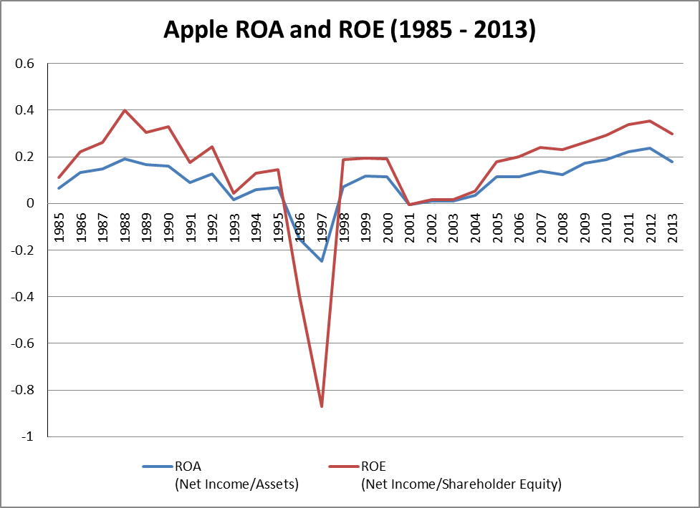
Supply Chain Finance
Notes:
Inventories on-hand dropped from over 80 days to less than 2 days; the number of days to get paid by customers dropped from almost 64 days to 40.5 days; and starting in 1996, the number of days to pay suppliers increased from 33 days to 68 days.

Slide 7
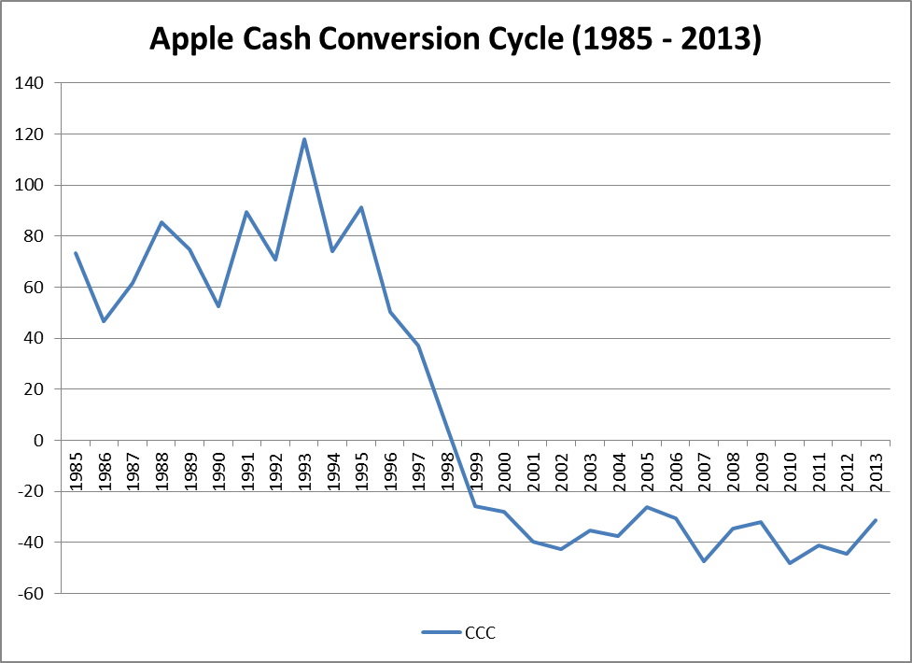
Supply Chain Finance
Notes:
Inventories on-hand dropped from over 80 days to less than 2 days; the number of days to get paid by customers dropped from almost 64 days to 40.5 days; and starting in 1996, the number of days to pay suppliers increased from 33 days to 68 days.

Slide 8
Supply Chain Finance
Supply chain flows: materials, information and financial (Gupta and Dutta, 2011)
Research focus
Examine Fortune 500 firms (excluding service companies)
Cash Conversion Cycle and firm performance
CCC = DIO – DPO + DSO
Inventory Theory
“Just–in-time” practices improve operations by reducing inventories
COMPUSTAT database
Longitudinal analysis of Supply Chain Finance strategies
Notes:
Supply chain management is the coordination among multiple partners linked through the downstream flow of materials, the upstream flow of cash, and information flowing in both directions (Gupta and Dutta, 2011)
the recent global economic downturn demonstrated that managing financial flows within the supply chain can be as important as managing physical flows of goods and services (Lind et al., 2012).
Citibank alone transacts an estimated $2.1 trillion (USD) per day in trade financing, which typically includes loans to suppliers for the purchase of raw materials, components and finished goods.

Slide 9
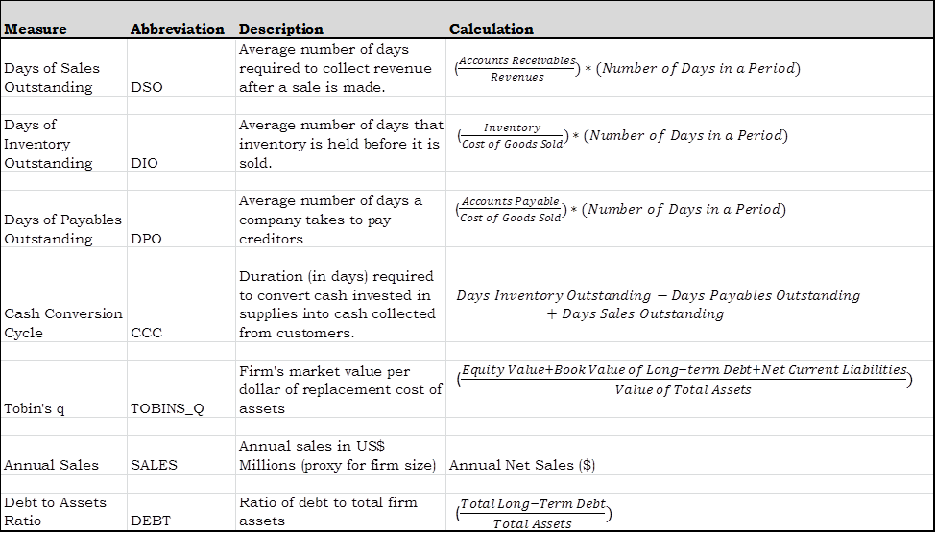
Supply Chain Finance

Slide 10
Supply Chain Finance
Research Question: What is the relationship between changes in a firm’s supply chain finance components and changes in its financial performance?
Days Inventory Outstanding
H1
Days Payables Outstanding
-
H2
+
Firm Performance
H3
Days Sales Outstanding
-
H4
-
Cash Conversion Cycle
Notes:
Research Question: What is the relationship between changes in a firm’s supply chain finance components (Days Inventory, Days Payables, Days Sales, Cash Conversion Cycle) and changes in its financial performance?
H1: The rate of change in Days Inventory Outstanding (DIO) is negatively associated with the rate of change in firm performance.
H2: The rate of change in DPO is positively associated with the rate of change in firm performance.
H3: The rate of change in Days Sales Outstanding (DSO) is negatively associated with the rate of change in firm performance.
H4: The rate of change in CCC is negatively associated with the rate of change in firm performance.

Slide 11
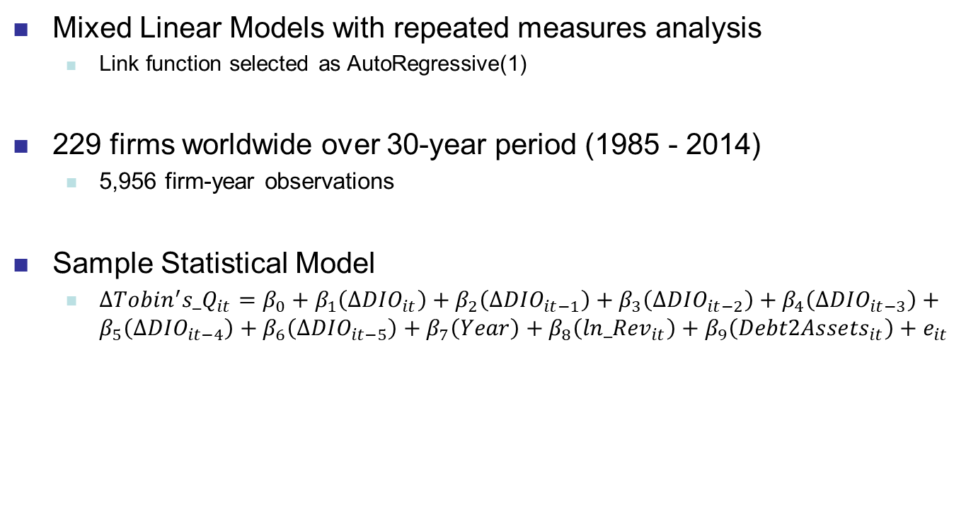
Supply Chain Finance
Mixed Linear Models with repeated measures analysis
Link function selected as AutoRegressive(1)
229 firms worldwide over 30-year period (1985 - 2014)
5,956 firm-year observations
Sample Statistical Model
$∆Tobin^{′}{s_Q}_{it}=β_{0}+β_{1}\left({ΔDIO}_{it}\right)+β_{2}\left({ΔDIO}_{it−1}\right)+β_{3}\left({ΔDIO}_{it−2}\right)+β_{4}\left({ΔDIO}_{it−3}\right)+β_{5}\left({ΔDIO}_{it−4}\right)+β_{6}\left({ΔDIO}_{it−5}\right)+β_{7}\left(Year\right)+β_{8}\left({ln_Rev}_{it}\right)+β_{9}\left({Debt2Assets}_{it}\right)+e_{it}$
Notes:
Analysis done in SAS v9.4
Mixed linear model with AutoRegressive1 (“ar1”) link function

Slide 12
Supply Chain Finance
Tobin’s q changes resulting from DPO change

Slide 13
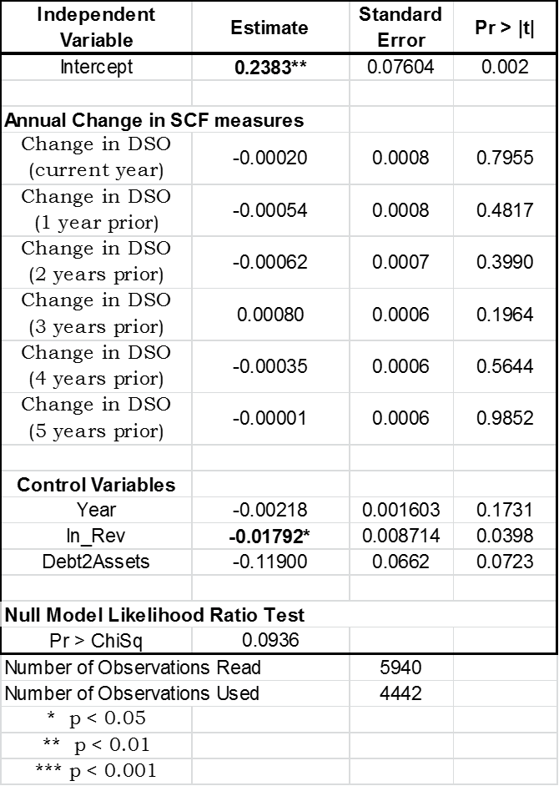
Supply Chain Finance
Tobin’s q changes resulting from DSO change

Slide 14
Supply Chain Finance
Tobin’s q changes resulting from DIO change
Notes:
No impact in current period but significant impact in periods 1, 2 and 3

Slide 15
Supply Chain Finance
Tobin’s q changes resulting from CCC change

Slide 16
Supply Chain Finance
Research Question: What is the relationship between changes in a firm’s supply chain finance components and changes in its financial performance?
Days Inventory Outstanding
H1 – supported. Significant impact for 3 years
Days Payables Outstanding
-
H2 - supported
+
Firm Performance
H3 – not supported
Days Sales Outstanding
-
H4 – supported. Significant impact for 2 years
-
Cash Conversion Cycle
Notes:
DIO was found to be the only SCF measure which had a significant effect on firm performance in multiple years. The largest impact on firm performance was seen one year later (β=-0.00341, p<0.0001) and nearly as large an impact two years later (β=-0.00224, p<0.0001). The statistically significant association continued to exist between DIO changes in firm performance changes three years later (β=-0.00133, p=0.002).
The positive coefficient estimation and statistical significance provide support for H2, that increases in the rate-of-change in DPO will positively influence the rate-of-change in firm performance.
Supply managers should not consider longer payments as a strategy for sustained financial success; instead, it is a short-term boost which may serve to benefit the firm while waiting for the benefits of inventory reduction strategies.
changes in DSO do not significantly influence firm performance in any period. One might be tempted to suggest that changes in DSO would create changes in future period performance as increased cash may be strategically invested, yet our analysis finds all time horizons are well outside the criterion for significance (p<0.05). We must conclude that there is not support for H3.
The associations between changes in CCC and changes in firm performance are significant in the current year (β=-0.00105, p=0.0039) as well as one and two years later (each p<0.0001). Similar to DIO, the direction of the rate-of-change CCC parameter estimates is negative and consistent across all time horizons. Our analysis finds support for H4 that decreasing changes in CCC is associated with increasing changes in firm performance over time.

Slide 17
Contributions
Extend Supply Chain Finance concept
Days Inventory changes
No impact in current period
Highly significant impact for 3 later periods
Importance of longitudinal data in Supply Chain research
Limitation 1 – Large, multinational firms only
Limitation 2 – Tobin’s q represents firm performance
Limitation 3 – SCF arrangements are assumed to be fully implemented
Notes:
Most importantly, we expand the concept of supply chain finance beyond the cash flow centric use in previous literature.
supply chain finance is truly a synergistic relationship between the focal firm and its network partners. Cash flow management is not enough to improve performance. Instead, strategic inventory management decisions have the largest impact and drive firm growth for years into the future.
while we recognize that the availability of SCF arrangements have increased dramatically over the last decade, our investigation considers that the focal firm implements SCF policies with all of its suppliers worldwide.

Slide 18
Thank you

Slide 19
Backup

Slide 20
References
Agrawal, N., Nahmias, S., 1997. Rationalization of the Supplier Base in the Presence of Yield Uncertainty. Production and Operations Management 6, 291–308.
Arya, B., Lin, Z., 2007. Understanding Collaboration Outcomes From an Extended Resource-Based View Perspective: The Roles of Organizational Characteristics, Partner Attributes, and Network Structures†. Journal of Management 33, 697–723. doi:10.1177/0149206307305561
Bellamy, M.A., Ghosh, S., Hora, M., 2014. The influence of supply network structure on firm innovation. Journal of Operations Management 32, 357–373. doi:10.1016/j.jom.2014.06.004
Borgatti, S.P., Li, X., 2009. On Social Network Analysis in a Supply Chain Context*. Journal of Supply Chain Management 45, 5–22.
Box, G.E.P., Tiao, G.C., 1975. Intervention Analysis with Applications to Economic and Environmental Problems. Journal of the American Statistical Association 70, 70. doi:10.2307/2285379
Burt, R.S., 1992. Structural holes: the social structure of competition. Harvard University Press, Cambridge, Mass.
Carnovale, S., Yeniyurt, S., 2014. The Role of Ego Networks in Manufacturing Joint Venture Formations. Journal of Supply Chain Management 50, 1–17.

Slide 21
References
Choi, T.Y., Kim, Y., 2008. Structural Embeddedness and Supplier Management: A Network Perspective*. Journal of Supply Chain Management 44, 5–13.
Coleman, J.S., 1988. Social Capital in the Creation of Human Capital. American Journal of Sociology 94, S95–S120. doi:10.2307/2780243
Dyer, J.H., Hatch, N.W., 2004. Using Supplier Networks to Learn Faster. MIT Sloan Management Review 45, 57–63.
Eldridge, N., Gould, S.J., 1972. Punctuated equilibria: An alternative to phyletic gradualism, in: Models in Paleobiology. Freeman, Cooper & Co., San Francisco, pp. 82–115.
Ellram, L.M., 1990. The Supplier Selection Decision in Strategic Partnerships. International Journal of Purchasing and Materials Management 26, 8.
Emerson, R.M., 1962. Power-Dependence Relations. American Sociological Review 27, 31–41. doi:10.2307/2089716
Galaskiewicz, J., 2011. Studying Supply Chains from a Social Network Perspective. Journal of Supply Chain Management 47, 4–8. doi:10.1111/j.1745-493X.2010.03209.x
Grusky, D.B., Western, B., Wimer, C.C., 2011. The Great Recession. Russell Sage Foundation.

Slide 22
References
Gulati, R., Sytch, M., 2007. Dependence asymmetry and joint dependence in interorganizational relationships: Effects of embeddedness on a manufacturer’s performance in procurement relationships. Adm. Sci. Q. 52, 32–69.
Gupta, S., Dutta, K., 2011. Modeling of financial supply chain. European Journal of Operational Research 211, 47–56. doi:10.1016/j.ejor.2010.11.005
Helper, S., 1991. Strategy and Irreversibility in Supplier Relations: The Case of the U.S. Automobile Industry. The Business History Review 65, 781–824. doi:10.2307/3117265
Huff, J., Rogers, D.S., 2015. Funding the Organization through Supply Chain Finance: A Longitudinal Investigation. Supply Chain Forum: An International Journal 16, 4–17. doi:10.1080/16258312.2015.11716348
Jose, M., Lancaster, C., Stevens, J., 1996. Corporate Returns and Cash Conversion Cycles. Journal of Economics and Finance 21, 33–46.
Ogden, J.A., Carter, P.L., 2008. The supply base reduction process: an empirical investigation. The International Journal of Logistics Management 19, 5–28. doi:10.1108/09574090810872578
Roberts, M., 2009. The Great Recession. Lulu.com.
Ramchandani, A., 2014. Incorporating Bidirectional Momentum Effects and Media Attention to Profitably Trade Economically Linked Companies.

